Slide 2
Play around project.
Can be, but does not have to be, related to discomfort project.
To clarify: 10 hours = full credit.
Discomfort project.
The vision: rather than being a time waster, interactive computing can support engaging with discomfort to produce progress.
Discomfort is uncomfortable, but triggers adaptation.
Pain is uncomfortable too, but reduces function.
Discomfortable (adj) an experience that produces discomfort.
Uncomfortable (adj) who one feels when experiencing discomfort.
If you want a variance from this vision for your project, dm me on slack.

Slide 3
Moving into Design of Everyday Things (DET).
Look ahead to the unusable widget project.
You’ll intentionally break one or more principles from DET
You’ll demo the widget and say which principle you broke.

Slide 4
For CS 456
This book is about the design of everyday products—computational or not.
Computation is drifting into everyday objects.
How should we design interfaces for everyday objects which contain computation?
And, on a different tack, What does it mean for the web and for mobile devices?

Slide 5
Unfindable Objects
Why don’t the things on the next slide work?
Why can’t the user make these things work?
Who’s fault is this?

Slide 6
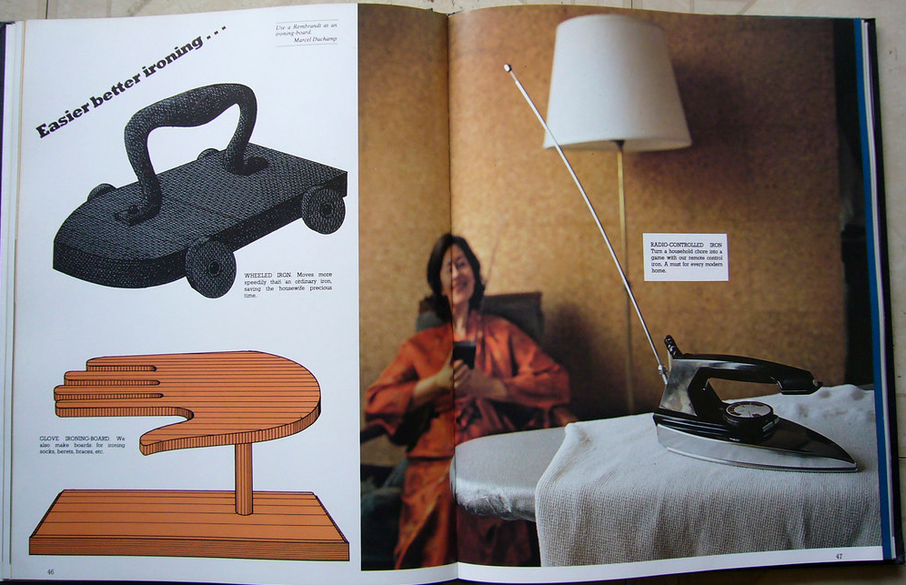
D

Slide 7
Discoverability and Understanding
Is it possible to figure out which actions are possible?
And where to perform those actions?
What does it all mean?
How is it supposed to be used?
What do all the different settings mean?
In other works: how does this work? And what can it do for me?

Slide 8
Discoverability and Understanding
Is it possible to figure out which actions are possible?
And where to perform those actions?
What does it all mean?
How is it supposed to be used?
What do all the different settings mean?
In other works: how does this work? And what can it do for me?

Slide 9
Dicoverability
Affordances
Signifiers
Constraints
Mappings
Feedback
Conceptual model of the system.

Slide 10
Affordances
This is where the term comes from.
Every other definition is wrong.
There are many other accepted definitions.
“An affordance is a relationship between the properties of an object and the capabilities of the agent that determine just how the object could possibly be used.”
“The presence of an affordance is jointly determined by the qualities of the object and the abilities of the agent that is interacting.”
“But affordance is not a property. An affordance is a relationship. Whether an affordance exists depends upon the properties of both the object and the agent.”

Slide 11
Examples
Affordance is a relationship
Between the object an the agent.
Glass affords transparency
A chair affords sitting
Some chairs with some people afford lifting.
Chair is light enough
Person is strong enough

Slide 12
Hidden Affordances
Affordances exist even if they aren’t visible.
“Perceived affordances help people figure out what actions are possible without the need for labels or instructions.”

Slide 13
Misappropriation of “affordance”
“Affordances are an object’s properties that show the possible actions users can take with it, thereby suggesting how they may interact with that object. For instance, a button can look as if it needs to be turned or pushed. The characteristics of the button which make it look “turnable” or “pushable” together form its affordances.”
-- Interaction design foundation
https://www.interaction-design.org/literature/topics/affordances

Slide 14
Signifiers
“signifier refers to any mark or sound, any perceivable indicator that communicates appropriate behavior to a person.”

Slide 15
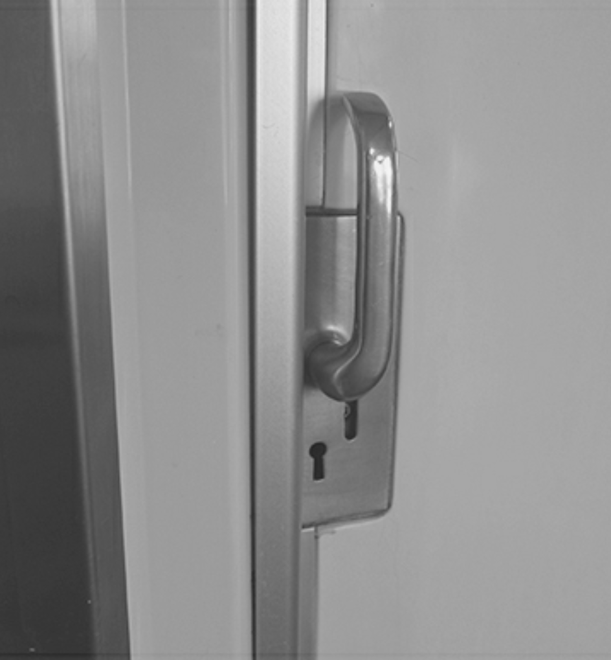
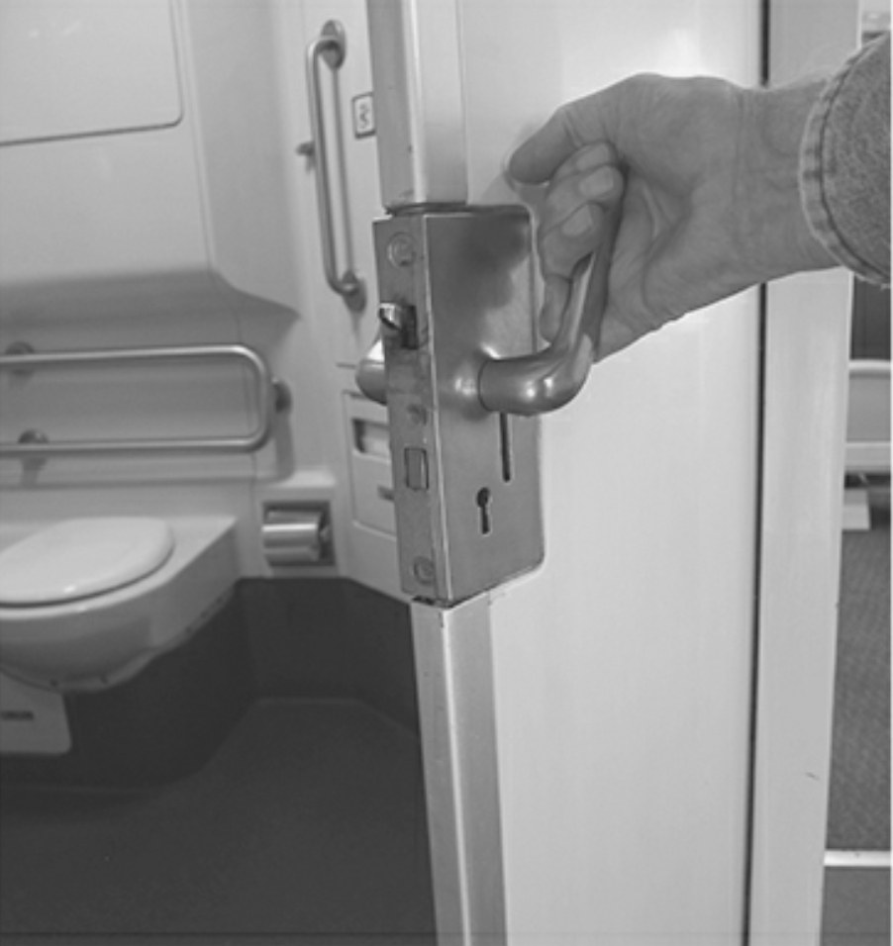
When Signifiers Fail

Slide 16
Focusing on signifiers
Signifier: communicates how to use the design.
Affordances: possibilities of how an agent can interact with something. Sometimes not perceived even if they exist.

Slide 17
Mapping
Which control controls which object or function.
Example: steering wheel on a car. Motion of the top of the wheel maps to motion of the car.
Guided by conceptual models.
Mapping between controls, actions and the result.

Slide 18
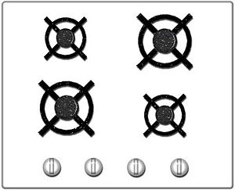
Mappings on a stove
https://en.wikipedia.org/wiki/Natural_mapping_(interface_design)

Slide 19
Constraints
The only way you can use it is the right way to use it.

Slide 20
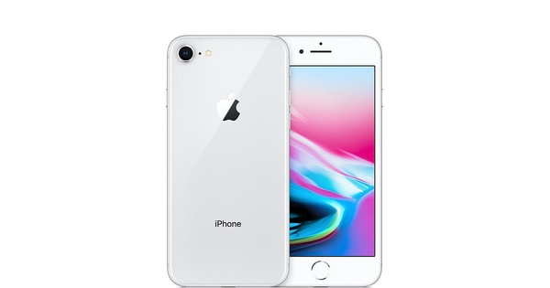
Feedback
Communicating the results of an action.
Planned to be unobtrusive and prioritized.

Slide 21
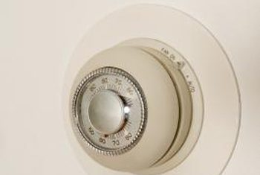
Conceptual Models
“A conceptual model is an explanation, usually highly simplified, of how something works”
https://homeguides.sfgate.com/heater-thermostat-need-replacing-60947.html

Slide 22


Slide 23
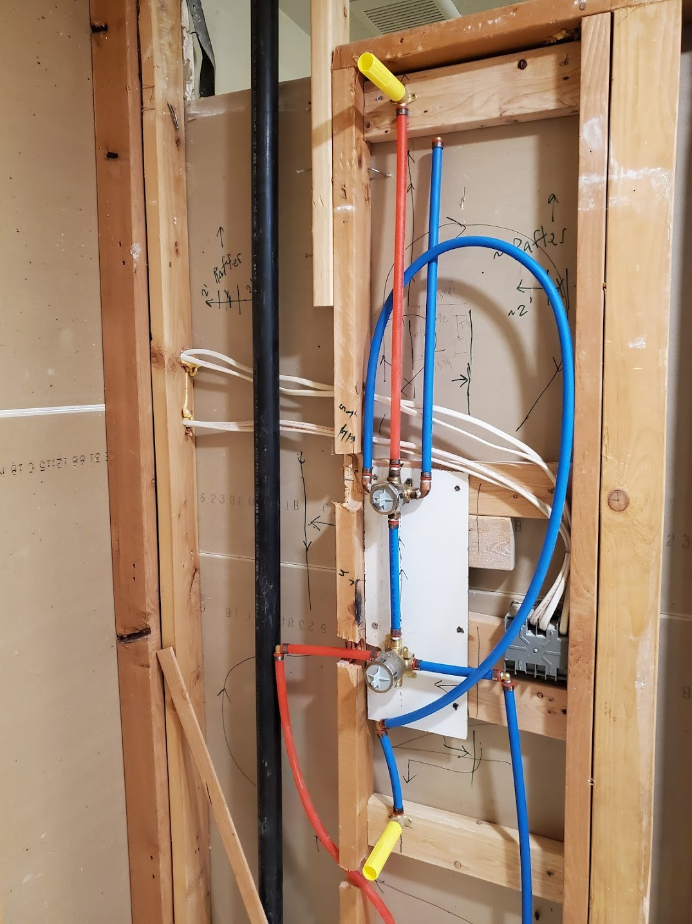

Slide 24

Example:
Affordances
Signifiers
Constraints
Mappings
Feedback
Conceptual model of the system.

Slide 25
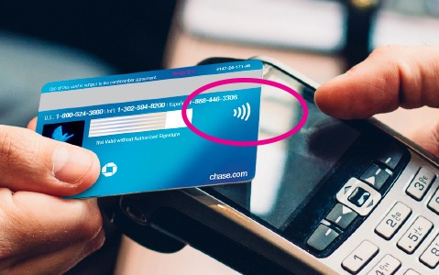
How do you think contactless payments work?
https://www.imore.com/which-credit-cards-support-contactless-payment

Slide 26
Contactless payments in a nutshell
Reader broadcasts RF energy.
That energy activates a chip on the card.
Reader sends an encryption key signed by the card issuers private key.
Card uses issuers public key to decrypt the encryption key.
Card uses decrypted encryption key to encrypt all future communication with reader
Reader sends transaction details (price, etc) to the card.
Card creates a message with the details (price) and card number. Encrypts with card’s private key.
Encrypted message forwarded by reader on to card issuer.
Card issuer uses the card’s public key to decrypt the transaction details and card number. Card issuer accepts or declines the transaction.
If card issuer accepts, the issuer sends a receipt to the card reader.
Reference numbers are generated and stored.

